Slide 1


THE ADA PROJECT
TEAM DELTA - DATA TRACK

Slide 2
REPORT ON SQL ANALYSIS OF MENTAL HEALTH SURVEY
Collaborators:
Eliel Godsent
Sophia Abubakar
Team Members:
Ifeanyi Michael
Akeem Abiodun
Ojukwu Shiela
Favour Joseph

Slide 3
Introduction
This project is basically centered on Mental Health Analysis. A dataset was provided for Structural Query Language Analysis to provide and ascertain four mental health insights with respect to annual survey questions asked and answers provided.

Slide 4

Objective
The primary purpose of this presentation is to communicate the awareness of the analysis conducted on the survey questions that have to do with mental health analysis.

Slide 5
Insights From The Dataset
To gain an insight into the database, several queries were run using the Structured Query Language (SQL) and the outputs are displayed in tables.
The survey consists of 4218 participants from several countries with the United States of America ranking the highest in responses.
Also, average age of participants can be seen below:
33.9153627311522

Slide 6
Inference 1
A total of 4218 distinct individuals took part in the surveys, majority of whom are from the United State, followed by United Kingdom, and Canada.
Average age is 34 and are mostly male. A sizable proportion of them work in the Tech space.
United States of America | 1853
United Kingdom | 482
Canada | 199

Slide 7
Inference 2
1237 affirmed to have a mental disorder, 969 gave a firm negative
response while 758 were unsure. We can infer that most people are mentally aware. In addition, mood disorder (Depression, Bipolar disorder, Anxiety disorder etc) are the most common mental conditions people believe that they may have.
758
969
1237
Unsure
Negative
Positive

Slide 8

Inference 3
It is also of high importance to note that there are more participants in the survey who have been diagnosed of mental health disorder than those who have not and those who are negative. In total, more people know their status than those who do not.

Slide 9
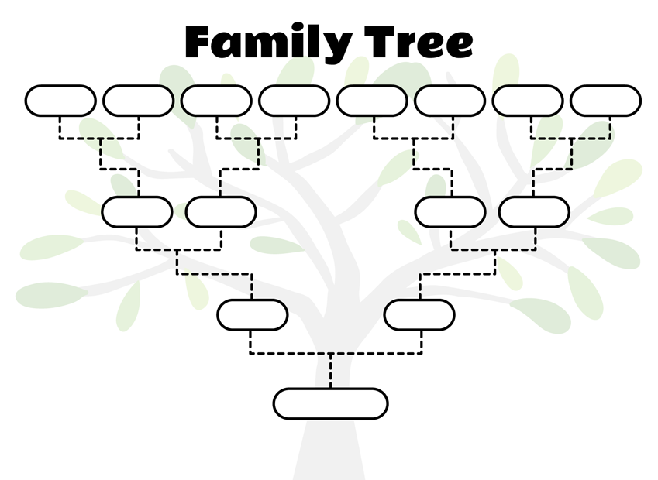
Inference 4
It can be seen that persons with a family history of mental illness are at higher risk of mental illness as most people with mental health challenges seem to also have persons with similar illness in their family history

Slide 10
Conclusion
While data shows a general high rate of awareness of individuals toward their mental health, and a high rate of mental health diagnosis, attitude towards people with mental health disorder is poor.
Also, people with mental disorder in their family History have higher chance of mental health disorder.

